Slide 1
Artificial Intelligence
Enrique Peláez Ph.D.

Slide 2
Agenda
Techniques for solving AI problems
Fundamentals of Artificial Intelligence
Problem resolution in AI
  Formal definition of a problem
  Solution techniques – search algorithms
    GENERATE-AND-TEST
    BREATH-FIRST
    DEPTH-FIRST

Slide 3
Techniques for solving AI problems
Commonly, to solve a problem, we need:
  To formally define the problem.
  Analyze the problem.
  Represent the necessary knowledge to solve the problem.
  Select the best technique to solve the problem and implement it.

Slide 4
Fundamentals of Artificial Intelligence s
Formal definition of a problem
  The first step in designing a solution of a problem is to create a formal description of it, and to reduce the problem in manageable pieces.
  There are artificial problems which are structured, then those are easy to specify.
  But, real world problem; such as, natural language understanding, and others are not simple to specify.

Slide 5

Fundamentals of Artificial Intelligence s
The Hanoi Tower

Slide 6

Fundamentals of Artificial Intelligence s
The Hanoi Tower

Slide 7

Fundamentals of Artificial Intelligence s
The Hanoi Tower (79)

Slide 8
Problem resolution in AI
To create a formal specification of a problem, we need to define:

Slide 9
Problem resolution in AI
To create a formal specification of a problem, we need to define:
  Space of valid states;

Slide 10
Problem resolution in AI
To create a formal specification of a problem, we need to define:
  Space of valid states;
  Initial state of the problem;

Slide 11
Problem resolution in AI
To create a formal specification of a problem, we need to define:
  Space of valid states;
  Initial state of the problem;
  Final or objective state;

Slide 12
Problem resolution in AI
To create a formal specification of a problem, we need to define:
  Space of valid states;
  Initial state of the problem;
  Final or objective state;
  Failure states

Slide 13
Problem resolution in AI
To create a formal specification of a problem, we need to define:
  Space of valid states;
  Initial state of the problem;
  Final or objective state;
  Failure states
  Rules that can be applied to allow a change in a state.

Slide 14
Problem resolution in AI
State search
Initial State
operator
Final State

Slide 15
Problem resolution in AI
A state is a representation of the problem in one specific moment.
The initial state consists of one or many states, in which the problem starts.
The objective or goal state consists of one or many final states that can be considered as an aceptable solution.

Slide 16
Problem resolution in AI
The rules describe the actions or operators that allow to move from state to another.
A rule is composed by a left and right side
The left side determines the applicability of the rule; that is, describe the states to which the rules can be applied.
The right side describes the operation/action that takes place if the rule is applied (fired); that is, to move to the next state.

Slide 17
Problem resolution in AI
For example, in the chess game:
  Each state, in the state space, represents the state of the chess board during the game;
  The initial state is an 8x8 board, where each cell contains a symbol that matches the piece of the chess set;
  The final state is defined as any configuration of the board in which the adversary can not make a legal move to “save” or eliminate a threat to the king.

Slide 18
Solution techniques in AI
Strategies for State Space Search
  Goal driven – backward chaining
  Take the goal to be solved. See what rules or legal moves could be used to generate this goal and determine what conditions must be true to use them.
  These new conditions become the new goals for the search, it works back to the facts of the problem.
  This finds the chain of moves or rules leading from data to goal, but backwards.

Slide 19
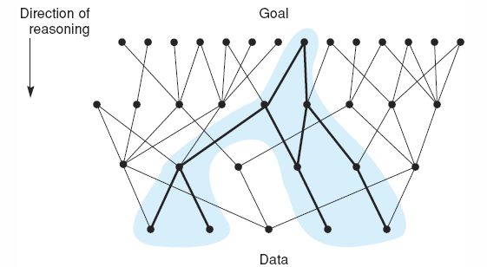
Solution techniques in AI
Goal-driven

Slide 20
Solution techniques in AI
  Data driven search– backward chaining
  Search begins with the given facts of the problem and a set of legal moves or rules for changing the state.
  Search proceeds by applying rules to facts to produce new facts, until it generates a path that satisfies the goal condition.

Slide 21
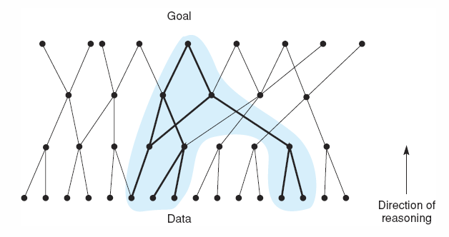
Solution techniques in AI
Data Driven

Slide 22
Search techniques
Types of search based on the control strategy:
ALGORITHM
  We have the information about the operations to be performed.
EXHAUSTIVE SEARCH (BLIND SEARCH)
  Explore the search tree systematically, but without information.
HEURISTIC SEARCH (INFORMED SEARCH)
  Reduce the search with information about the problem domain.

Slide 23
Search techniques
Strategies for blind search
Generate and Test
Breadth First
Depth First
Uniform cost search
Limited depth
Interactive depth
Bidirectional search

Slide 24
GENERATE-AND-TEST
GENERATE-AND-TEST
  Generate one possible solution, (estate or path)
  Test to see if it is the solution. Compare it against the elements of a set of acceptable solutions.
  If a solution has been found, return. If not, go to step 1.

Slide 25
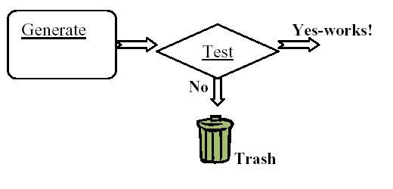
GENERATE-AND-TEST

Slide 26
GENERATE-AND-TEST
An improvement of the algorithm is to ensure that a solution is not tested more than once. This can be done by enumerating the solutions, and test them in order.
If the solutions can not be enumerated, generate the solutions randomly, but keep a list or an array with all the tested solutions, to search a potential solution before it is tested.
  This alternative has some problems. It can take time to search for a tested solution, when the list grows.
If the set of possible solutions is big, a better option is to generate randomly a solution without testing.

Slide 27
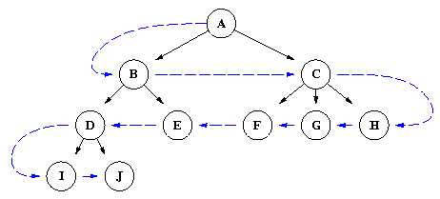
Breath - First

Slide 28
    Breath - First
  Begin
  open := [Start];
  closed := [ ];
  while open π [ ] do
  begin
  remove leftmost state from open, call it X;
  if X is a goal then returns SUCCESS
  else begin
  generate children of X;
  put X on closed;
  discard children of X if already on open or closed;
  put remaining children on right end of open
  end
  end
  return FAIL
  end

Slide 29
Breath - First
A
B
C
D
E
F
G
H
I
J
K
L
M
N
O
P
Q
R
S
T
u

Slide 30
Breath - First
open = [A]; closed = [ ]
open = [B,C,D]; closed = [A]
open = [C,D,E,F]; closed = [B,A]
open = [D,E,F,G,H]; closed = [C,B,A]
open = [E,F,G,H,I,J]; closed = [D,C,B,A]
open = [F,G,H,I,J,K,L]; closed = [E,D,C,B,A]
open = [G,H,I,J,K,L,M] L is in open; closed = [F,E,D,C,B,A]
open = [H,I,J,K,L,M,N]; closed = [G,F,E,D,C,B,A]
Continue until U is found, or open = [ ].

Slide 31
Breath - First
With breath first, once a solution is found, the route from the initial state to the goal state is the shortest route.
One disadvantage of this algorithm is that to reach a solution, in the n^{th} level, it has to explore the state space to that level.

Slide 32
Breath - First
Complete
  Yes, (including for implicit infinite trees)
  Always finds the shortest route
Time
  O(b^{m})
m
b
d
G

Slide 33
Breath - First
Memory
  The maximum number of nodes is reached at level “m” (objective)
  In general: b^{m}
  Usually “worse” than depth-first
m
b
d
G

Slide 34
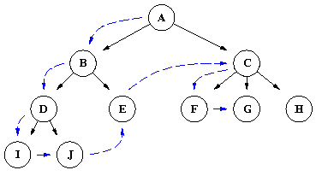
Depth - First

Slide 35
Depth - First
  Begin
  open := [Start];
  closed := [ ];
  while open π [ ] do
  begin
  remove leftmost state from open, call it X;
  if X is a goal then returns SUCCESS
  else begin
  generate children of X;
  put X on closed;
  discard children of X if already on open or closed;
  put remaining children on left end of open
  end
  end
  return FAIL
  end

Slide 36
Depth - First
A
B
C
D
E
F
G
H
I
J
K
L
M
N
O
P
Q
R
S
T
u

Slide 37
Depth - First
open = [A]; closed = [ ]
open = [B,C,D]; closed = [A]
open = [E,F,C,D]; closed = [B,A]
open = [K,L,F,C,D]; closed = [E,B,A]
open = [S,L,F,C,D]; closed = [K,E,B,A]
open = [L,F,C,D]; closed = [S,K,E,B,A]
open = [T,F,C,D]; closed = [L,S,K,E,B,A]
open = [F,C,D]; closed = [T,L,S,K,E,B,A]
It continues until U is found U, or open = [ ].

Slide 38
Depth - First
Complete
  Si --> infinite trees
Time
  In the worse case scenario
    The final state could be at last branch of the tree
    O(b^{d})
d
b
G

Slide 39
Depth - First
Memory
  In general: O(d*b)
...

Slide 40

Search Strategies

